Slide 1
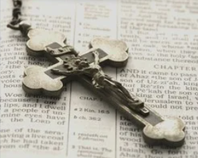
John
How Do I Develop a more active prayer life?
Curated by Team #2

Slide 2

‘How to Develop a More Active Prayer Life’
Opening Prayer
Walt
Dear God,
We love and honor you Father, Son, and Holy Spirit.
Thank you for bringing this group of Fathers together this morning. Today we are discussing how to develop a more active prayer life. Dear Lord, please open our hearts and minds to hear and understand one another as we discuss our prayer lives. Help us to provide one another insight as we share the obstacles and road blocks we face in our prayerful communications with you God. Help us recognize our needs and our strengths as we consider the various forms our prayers can take. And help us embrace the potential value in our lives that springs from a more intentional life of prayer.
Finally, Lord, help us to value the two-way communications available to us through prayer. Let us take enough time to not only actively pray, but to actively listen as well. Dear Lord, “when we hear your voice, harden not our hearts.”

Slide 3
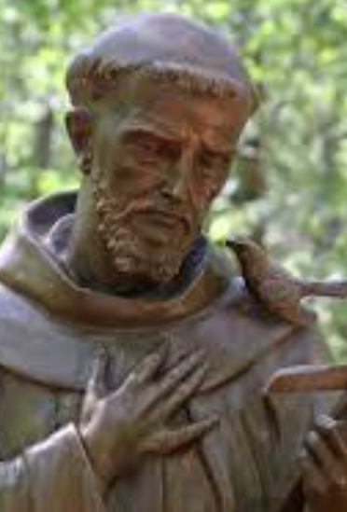
Prayer of St. Francis
https://youtu.be/agPnMxp5Occ
Vince

Slide 4
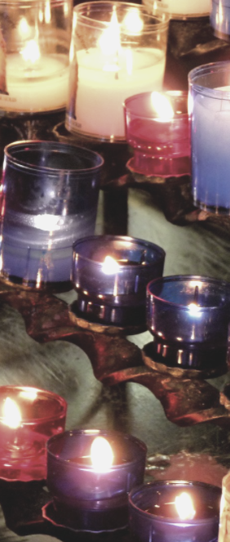
General George’s Prayer Journey Reflection
George
George
God as an ATM machine
What's really important in Prayer
*praying with the heart
*making a connection with God with minimal distractions
*looking for opportunities to pray EVERY DAY
*praying is like breathing for the soul
My Daily Prayers
*Thanksgiving
*Self Offering
*Praying before and after receiving the Holy Eucharist
*Consecration to Blessed Virgin Mary
*Rosary (meditating on Sacred Scripture)

Slide 5

Time for God
A Guide to Mental Prayer by Jacques Philippe
Ted
Material Conditions for Mental Prayer - Time
  All times are good for praying, however, one should try to pray at the most favorable time – when the mind is relatively fresh and not crowded with pressing concerns.
  A quarter of an hour should be the absolute minimum. Five minutes are not enough for God since that is what we give to someone when we want to get rid of them.
  As a general rule, we must keep faithfully to a minimum length and not give into temptation to shorten it.
  Time after the Eucharist is a privileged time for mental prayer.

Slide 6
Time for God
A Guide to Mental Prayer by Jacques Philippe
Ted
Material Conditions for Mental Prayer - Place
  It is desirable to find a place that favors silence, recollection and attention to God’s presence.
  The best place is a chapel with the Blessed Sacrament, particularly if it is exposed.
  If done at home, it is ideal to have a dedicated space for prayer, with icons, candle alter, or whatever else helps. At times we need material things to help us with devotion.

Slide 7
Time for God
A Guide to Mental Prayer by Jacques Philippe
Ted
Some Methods of Mental Prayer
  Lectio Divina – reading of scripture followed by meditation, trying to understand what God wants to tell us through the text.
  The “Jesus Prayer” – repetition of a short formula that contains the name of Jesus, such as “Lord Jesus, Son of the Living God, have mercy on me, a sinner!”. The advantage of this prayer is that it is poor, simple, and based on an attitude of great humility.
  The Holy Rosary
    The name of Jesus is at the heart of the Hail Mary.
    Mary leads us into her own prayer and introduces us into the mysteries of her Son.
    Mary somehow offers us a share into her own mental prayer, surely the deepest ever.

Slide 8
Ted
Here is a point worth underlining:
The mental prayer should not be treated as something exceptional, done at a time snatched with difficulty from other activities, but should be a habit, part of the normal rhythm of our lives, so that its place is never questioned, even for a single day. This will foster fidelity to mental prayer, which is essential. Life is shaped by rhythms: the rhythm of heart-beat and breathing, the rhythm of day and night, of meals, of weeks, and so on.
Mental prayer should become a daily event as vital to us as the basic rhythms of existence. It should become the breathing of our souls.” (page 83)

Slide 9
Steve
“A loving conversation with Him whom you know loves you.” - St. Theresa of Avila
Father, Friend, Confidant, Counselor
Philippians 4:6
Have no anxiety at all, but in everything, by prayer and petition, with Thanksgiving, make your requests known to God.

Slide 10

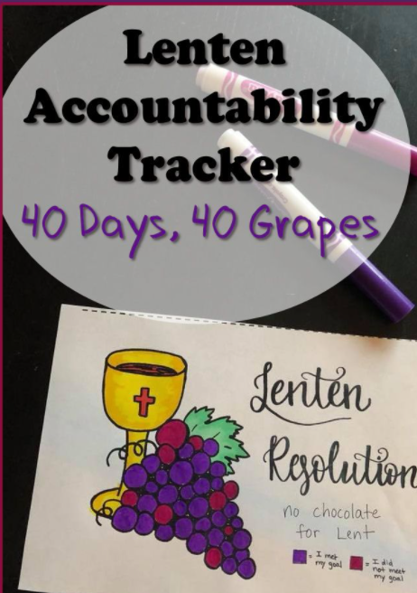
Ken
Team #2
Small Group Challenge
Use Lent to incrementally improve prayer life
Commit today…hold each other accountable
Please contact Ken Mai at:
Kenwmai@gmail.com

Slide 11
Resources
Ken
UCCB daily readings https://bible.usccb.org/daily-bible-reading
Bishop Barron’s Daily Gospel Reflection https://dailycatholicgospel.com/sign-up-daily-gospel
University of Notre Dame Daily Gospel & Reflections http://faith.nd.edu/s/1210/faith/interior.aspx?sid=1210&gid=609&pgid=5683&cid=15492
Dynamic Catholic Daily Reflections https://www.dynamiccatholic.com/daily-reflections.html
Dynamic Catholic’s Best Lent Ever https://www.dynamiccatholic.com/lent/best-lent-ever.html
Formed Daily Reflections https://watch.formed.org/browse
Formed Daily Lenten Reflections https://formed.org/lent

Slide 12
Chad, let’s send everyone to their small group
John

