Slide 1
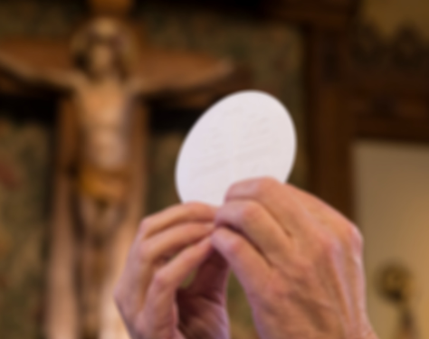
What’s the Purpose of the Mass?

Slide 2
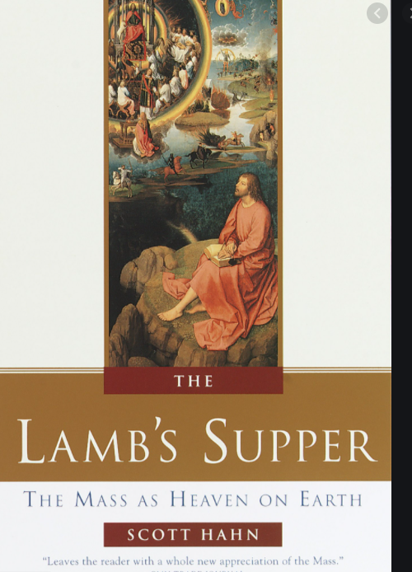
The Veil Removed
Mike Suter
https://www.bing.com/videos/search?q=the+veil+removed%2fyoutube&view=detail&mid=6293CF01BE23714A0D906293CF01BE23714A0D90&FORM=VIRE0&ru=%2fsearch%3fq%3dthe%2bveil%2bremoved%252Fyoutube%26src%3dIE-SearchBox%26FORM%3dIESR4A%26PC%3dUF03
Heaven on earth

Slide 3
Prayer
John Murphy

Slide 4
Readings
John F.
1 Cor 11: 23-26
For I received from the Lord what I also handed on to you, that the Lord Jesus, on the night He was handed over, took bread, and, after He had given thanks, broke it and said, “This is My body that is for you. Do this in remembrance of Me.” In the same way also the cup, after supper, saying, “This cup is the new covenant in My blood. Do this, as often as you drink it, in remembrance of Me.” For as often as you eat this bread and drink the cup, you proclaim the death of the Lord until he comes.
Acts 20:7
On the first day of the week when we gathered to break bread, Paul spoke to them because he was going to leave on the next day, and he kept on speaking until midnight.
Luke 4: 18-21
He stood up to read and was handed a scroll of the prophet Isaiah. He unrolled the scroll and found the passage where it was written: “The Spirit of the Lord is upon Me, because he has anointed Me to bring glad tidings to the poor. He has sent Me to proclaim liberty to captives and recovery of sight to the blind, to let the oppressed go free, and to proclaim a year acceptable to the Lord.” Rolling up the scroll, He handed it back to the attendant and sat down, and the eyes of all in the synagogue looked intently at Him. He said to them, “Today this scripture passage is fulfilled in your hearing.”

Slide 5
Catechism
John Wagner
Catechism 1322
The holy Eucharist completes Christian initiation. Those who have been raised to the dignity of the royal priesthood by Baptism and configured more deeply to Christ by Confirmation participate with the whole community in the Lord's own sacrifice by means of the Eucharist.
Catechism 1323
At the Last Supper, on the night he was betrayed, our Savior instituted the Eucharistic sacrifice of his Body and Blood. This he did in order to perpetuate the sacrifice of the cross throughout the ages until he should come again, and so to entrust to his beloved Spouse, the Church, a memorial of his death and resurrection: a sacrament of love, a sign of unity, a bond of charity, a Paschal banquet 'in which Christ is consumed, the mind is filled with grace, and a pledge of future glory is given to us.

Slide 6
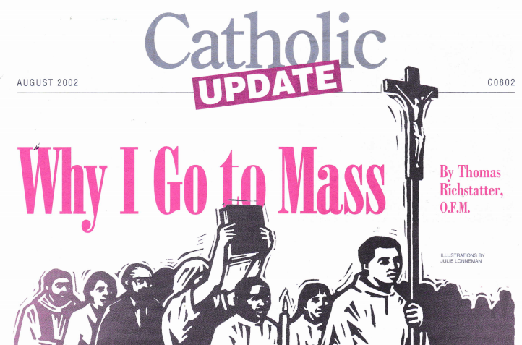
Why I go to Mass
John Wagner
I need others to pray well
Besides talking to God, I need God to talk to me
Mass enables me to pray with my whole body
Being born once again, didn’t quite do it
The mass helps me find the sacred in the ordinary

Slide 7
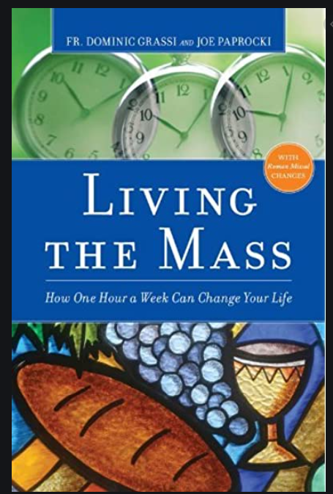
Living the Mass
Mike Suter
Chapter 1, Beginning with the End in Mind: Thanks Be to God
Chapter 2, From Individuals to Community: The Introductory Rites
Chapter 3, A Healthy Dose of Humility: The Penitential Act
Chapter 4, Ordinary Lives in an Extraordinary Context: The Scripture Readings
Chapter 5, Making Sense Out of Life: The Homily
Chapter 6, In God We Trust: The Profession of Faith
Chapter 7, Pray as if Your Life Depended on It: The Prayer of the Faithful
Chapter 8, Stewards of God’s Gifts: The Presentation of the Gifts
Chapter 9, We Give Thanks and Remember: The Eucharistic Prayer
Chapter 10, Courage and Confidence: The Lord’s Prayer
Chapter 11, Let Peace Begin with Me: The Sign of Peace
Chapter 12, God Alone Sustains Us: Holy Communion
Chapter 13, Go!: The Concluding Rites

Slide 8
Preparing Children
John Murphy

Slide 9
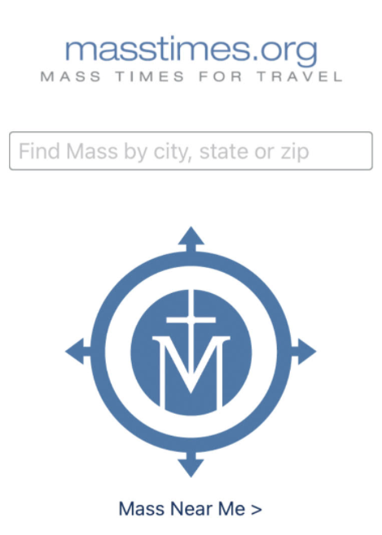
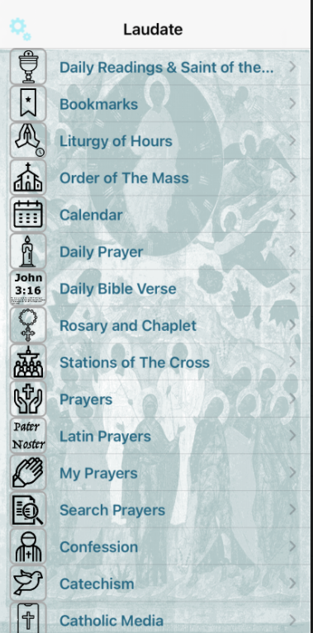
Resources
Suggested resources:
Quotes by various saints on the Mass https://liturgyguy.com/2017/04/04/8-saints-on-the-holy-mass/
Catalina’s vision of what happens at Mass
https://www.michaeljournal.org/articles/roman-catholic-church/item/the-holy-mass

Slide 10
Questions/Action
Action Plan:
Come up with 1 or more things you will do to have a better experience at Mass. Some suggestions:
1. Review the readings for the Mass a few days prior and any reflections that might be available.
2. Arrive to Mass 10 minutes earlier than usual to give yourself a chance to settle into the right frame of mind.
3. Sit in a different section of the church to see if your perspective changes your experience. (Or even attend a different church to see how their procedures might differ from what you’re used to.)
4. Read a book or other information explaining the Mass.
5. Take a journal with you and write down things that strike you during the Mass. Reflect on them later during quiet prayer time.
6. Make it a practice to “debrief” the Mass with those with whom you attend – see what you each got out of it.
7. Have you ever gone to Mass with a non-Catholic? How would you explain it to them?

