Slide 1
Team 1 Consecration to St. Joseph

Slide 2
Opening Prayer
John Wagner

Slide 3
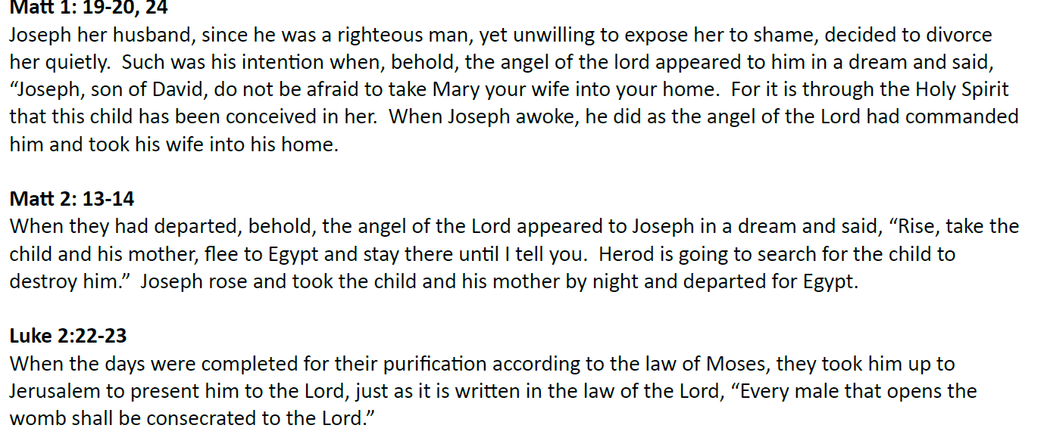
Readings
Dave Dettmer

Slide 4
Catechism
John Fahrmeier

Slide 5
Chad
Song
https://www.youtube.com/watch?v=SK_q2mpSMsM

Slide 6
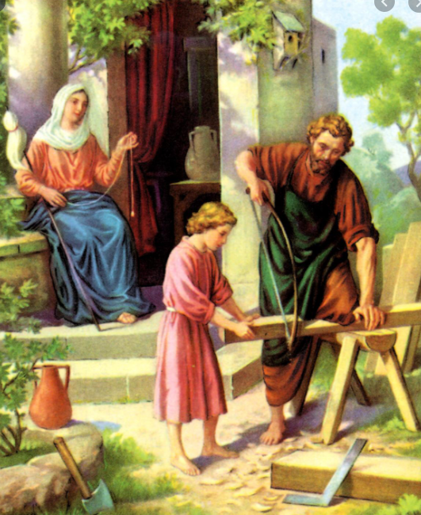
Mike
Exhortation by JP2
THE GOSPEL PORTRAIT
Marriage to Mary
THE GUARDIAN OF THE MYSTERY OF GOD
The Service of Fatherhood
The Census
The Birth at Bethlehem
The Circumcision
Conferral of the Name
The Presentation of Jesus in the Temple
The Flight into Egypt
Jesus' Stay in the Temple
The Support and Education of Jesus of Nazareth
A JUST MAN A HUSBAND
WORK AS AN EXPRESSION OF LOVE
THE PRIMACY OF THE INTERIOR LIFE
PATRON OF THE CHURCH IN OUR DAY
http://www.vatican.va/content/john-paul-ii/en/apost_exhortations/documents/hf_jp-ii_exh_15081989_redemptoris-custos.html

Slide 7
Mike
St. Teresa of Avila
St. Teresa of Avila had a special devotion to him, and argued that Joseph, the man of listening silence, was a special patron of the “interior life,” that life of seeking God in the deepest center of our heart
I wish I could persuade everyone to be devoted to this glorious saint, for I have great experience of the blessings which he can obtain from God. I have never known anyone to be truly devoted to him and render him particular services who did not notably advance in virtue, for he gives very real help to souls who commend themselves to him. For some years now, I think, I have made some request of him every year on his festival and I have always had it granted. If my petition is in any way ill directed, he directs it aright for my greater good.

Slide 8
Reflection
John Murphy

Slide 9
What does consecration mean?
Mike S.
Acknowledge that Joseph is your spiritual father, and you want to be like him.
To show it, you entrust yourself entirely to his paternal care so that he can lovingly help you acquire his virtues and become holy.
The person who consecrates himself to St. Joseph wants to be as close to their spiritual father as possible, to the point of resembling him in virtue and holiness.

Slide 10
Consecration to St. Joseph
Mike
In order to defend marriage and the family, elevate morals, recover lost ground, and win souls for Jesus Christ, we need to bring St. Joseph onto the battlefield.
He is the Terror of Demons!
With his powerful spiritual fatherhood, incredible love for his spiritual father, incredible love for his spiritual children, and constant intercession, the Church can be renewed as a light to the nations

Slide 11
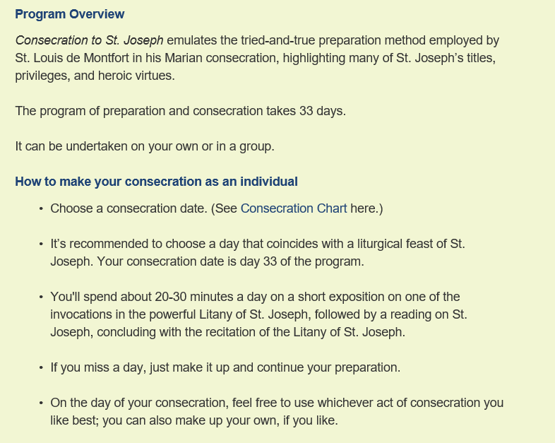
Dave S.
Consecration to St. Joseph, The Wonders of Our Spiritual Father, Donald H. Calloway, MIC Introduction to the Consecration to St. Joseph online:
https://www.consecrationtostjoseph.org/introduction.html

Slide 12
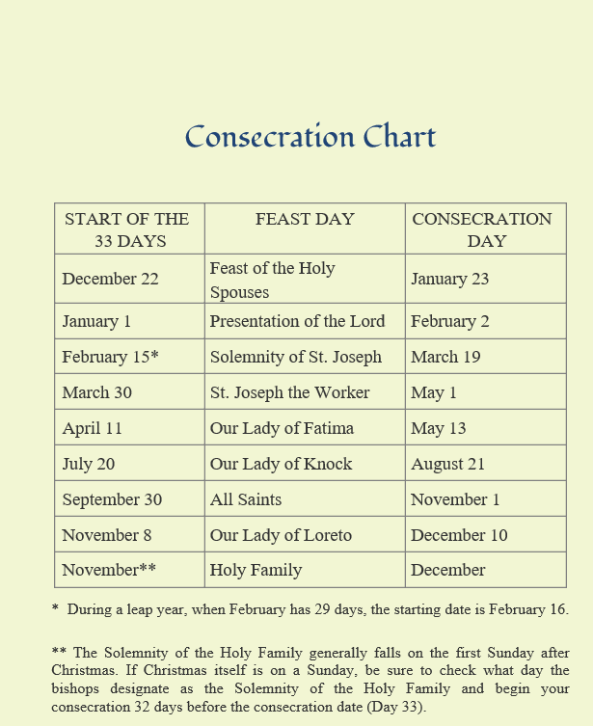
Dave S.

Slide 13
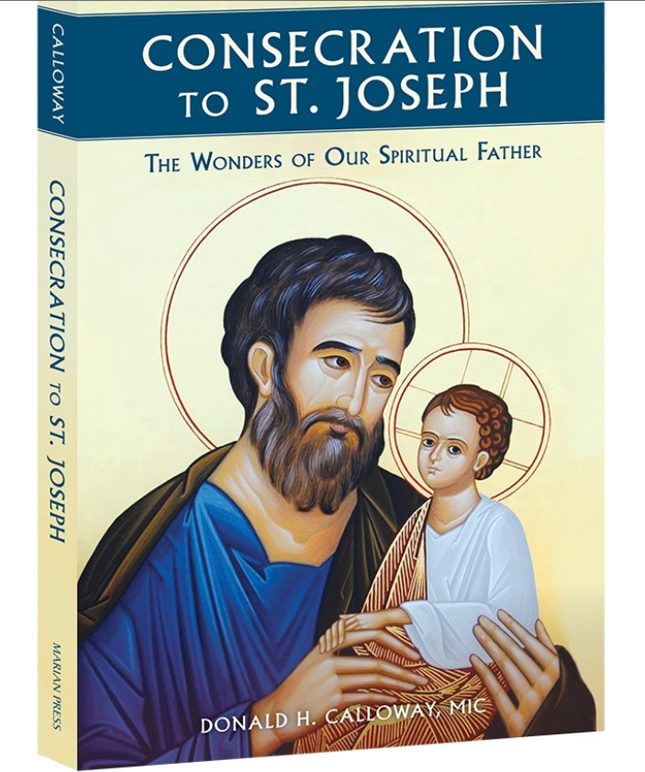
Dave S.
Consecration Guide
Hard Copy, Audio, Ebook
https://www.shopmercy.org/consecration-to-st-joseph-the-wonders-of-our-spiritual-father.html?source=ctsj

Slide 14
Large Group
Has anyone done a Consecration to St. Joseph?

Slide 15
Small Group Questions / Action
Have you considered St. Joseph as a role model for fathers?
As head and guardian of the Holy Family St. Joseph is protector of the Holy Church. Were you aware that he held such stature in the Church?
During these difficult times how can we defend Family and the Holy Church
Consider beginning your consecration to St. Joseph on Dec. 22.
There is a 33-day preparation of prayer and reflection which concludes with the Consecration to St. Joseph.

Slide 16
Resources
Consecration to St. Joseph, The Wonders of Our Spiritual Father, Donald H. Calloway, MIC
Introduction to the Consecration to St. Joseph online:
https://www.consecrationtostjoseph.org/introduction.html
The Litany of St. Joseph, http://osjusa.org/prayers/litany-st-joseph/
https://www.wordonfire.org/resources/blog/st-joseph-the-great/26855/
http://www.catholicdigest.com/amp/faith/spirituality/what-st-joseph-meant-to-jesus/

