Slide 1

It’s not just a game, it’s your life…
Jody Detzel

Slide 2
agenda
Introduction
What’s the fuss – why should parents care?
Ok – So how do I deal with it?
  The Basics
  How do I start – what do I protect?
    PC
    IOS/Mobile Phones
    Gaming
Other Resources

Slide 3
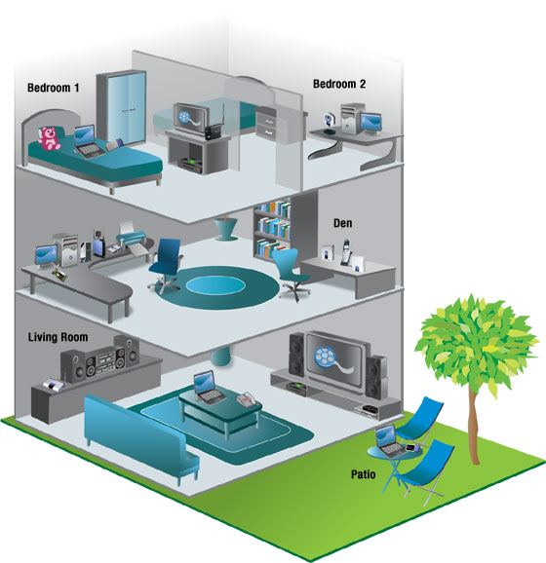
My thoughts on Tech
Notes:
Current tech Inventory
7 computers in the home
1 Server, 2 laptops & 4 desktop computers (one hooked up to the TV for full web content)
2 Xbox 360’s, and 1 “old” Xbox
1 Wii
iPad 1 and 2
2 IPod touch 3g’s
iPhone 3g, 3gs, 4g
Windows phone
Gigabit Ethernet, and 802.11n throughout the house
Passion for technology, and need for convergence.
Between work and home – I’m “online” every waking hour.
Technology is my job, and my hobby, and I’m passionate about the power and potential of technology to positively impact everything we do.
I subscribe to Wired, Popular Science and Popular Mechanics magazines, and tinker with stuff my family wishes I wouldn’t (like the kids ipods)
Using technology I monitor our electricity usage at home, and now have moved full bore into LED lighting, and other energy saving tech, after exploring wind and solar.
I love working at Microsoft because I enjoy the fact that I know that with microsoft technology, and tech in general, I can absolutely bring something of value to any organization that I would work with, increase efficiencies, communication, collaboration, whatever…
I no longer use a phone at the office. My cell minutes have been cut from unlimited to 1400 as a family/month. I have started impromptu 5 person conference calls from airplane wifi.
My family skypes with friends out of town, and out of country. First video conference as a family was in 2004.
First “internet” device was blackberry in 1997

Slide 4
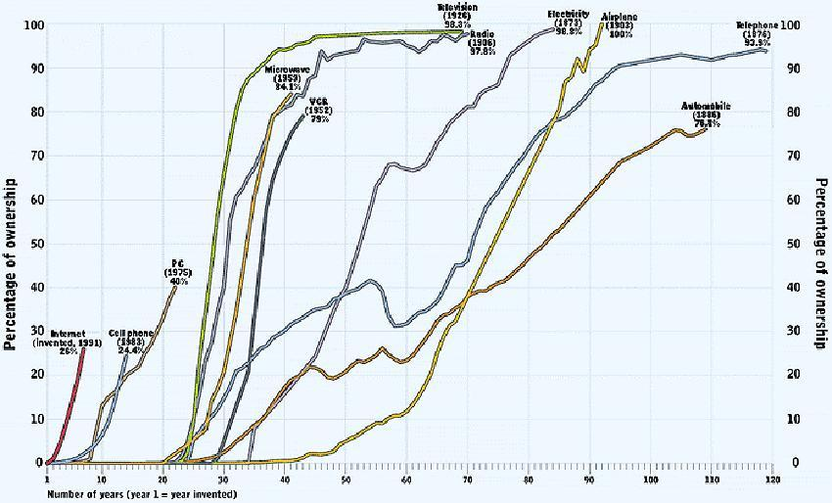
Internet Pervasiveness
Notes:
This chart was created in 1997 by Richard Solano of Duke University. By June of 2010, 77.3% of the US population was on internet according to ITU – the UN agency for Internet and communications “Connecting the worlds people.”

Slide 5
80%
94%
98%
65%
50%
Notes:
Lee Rainie
Director – Pew Research Center’s Internet & American Life Project
2.23.12
80% – internet pop February 2012
98% -- internet population of those in households earning more than $75,000
65% -- internet population of those in households earning less than $30,000
94% -- those 18-29 online
50% -- those 65 and older

Slide 6
    ThinkUKnow Video “Where’s Klaus”

Slide 7

Everything Changed (again) in 2007

Slide 8


Now
I can get anywhere… from anywhere…

Slide 9

Notes:
10% -- number of all adults who owned tablet computers in mid-December 2011
19% -- number of all adults who owned tablet computers in mid-January 2012

Slide 10
Quick Story (Washington Post 5/8/2011)
When Scott Fitzsimones turned 13, he got an iPhone, set up accounts for Facebook and Pandora and went on an apps downloading spree. At the same time, the new teenager lost many protections over his privacy online.
The games he plays know his location at any given moment through the phone’s GPS technology. He has entered his parents’ credit card number to buy apps, and iTunes has his family’s e-mail address and everyone’s full names. Facebook knows his birth date and the school he attends.
At an age when his parents won’t let him go to the mall alone and in an era when he would never open up to a stranger, Fitzsimones, who lives in Phoenix, already has a growing dossier accumulating on the Web.

Slide 11

Notes:
Source: The Pew Research Center Internet & American Life Project Teen & Parent surveys. Methodological information for each survey is available from http://pewinternet.org/Data-Tools/Download-Data/Data-Sets.aspx?topicFilter=aff4e2b2-7c23-4fdc-9ca6-fcf6815efd56

Slide 12
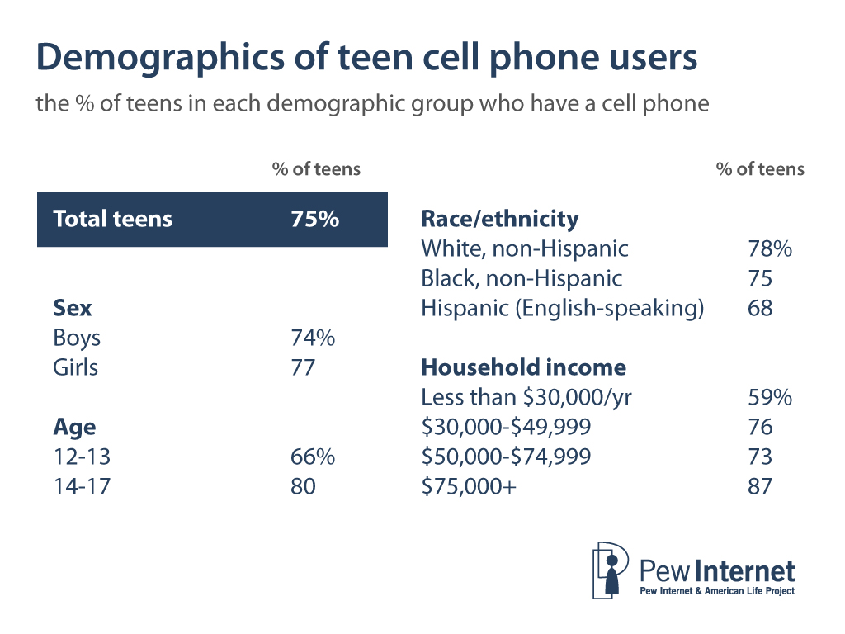
Notes:
Source: The Pew Research Center Internet & American Life Project Teen & Parent surveys. Methodological information for each survey is available from http://pewinternet.org/Data-Tools/Download-Data/Data-Sets.aspx?topicFilter=aff4e2b2-7c23-4fdc-9ca6-fcf6815efd56

Slide 13
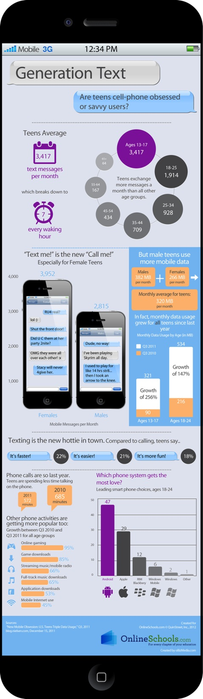

Slide 14
Latest data on “sexting”
2009
2011
4% of teens 12 to 17 have sent
15% of 12-17 year olds with cell phones have received
No gender or age differences in sending
Older teens more likely to receive
2% of teens 12-17 have sent
18% of 12-17 year olds with cell phones have received
No gender or age differences in sending
Older teens more likely to receive (21% of 16-17 vs. 6% of 12-13)
Notes:
Source: The Pew Research Center's Internet & American Life Teen-Parent survey, April 26-July 14, 2011. n=799 for teens and parents, including oversample of minority families. Interviews were conducted in English and Spanish.

Slide 15

Then…

Slide 16

We had online too…

Slide 17
The Convergence of Lives
Physical Life
Digital Life
Social Life
“To youth, social media and technologies are not something extra added on to their lives; they’re embedded in their lives. Their offline and online lives have converged into one life.”¹
We Are Here
1: Youth Safety on a Living Internet: Report of the Online Safety and Technology Working Group - June 4, 2010 - Page 5

Slide 18
With it’s own new language
Unique and evolving influence on popular culture
Online terminology (gaming and other) is creating new forms of communication:
  Gamer-tag: Universal term for player name on XboxLIVE
  Griefing: Making it harder for others to play (i.e. purposefully crashing cars, etc.
CTN | “Can’t Talk Now”
POS or P911 | “Parent Over Shoulder”
MMORG | “Massively Multiplayer Online Role-Playing Game”
OST | “Original Sound Track” on a game title
BRB | “Be Right Back”
WTG | “Way To Go!” (literal and ironic)
RMT | “Real Money Trade” in a virtual reality game
ROFL | “Rolling On the Floor Laughing”
http://www.theesa.com/facts/gameplayer.asp

Slide 19
  80% of parents who use social media and who also have a child who uses SM have friended their child.
77% of parents of online teens have checked to see what websites their child visited, up from 65% of parents who did this in 2006.
66% of parents have checked to see what information was available online about their child.
54% of parents of online teens report using parental controls or other means of blocking, filtering, or monitoring their child’s online activities.
34% of parents say they have used parental controls to restrict their child’s use of a cell phone.
Notes:
Source: The Pew Research Center's Internet & American Life Teen-Parent survey, April 19-July 14, 2011. N=799 for teens and parents, including oversample of minority families. Interviews were conducted in English and Spanish.

Slide 20
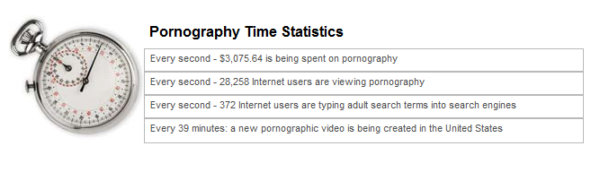
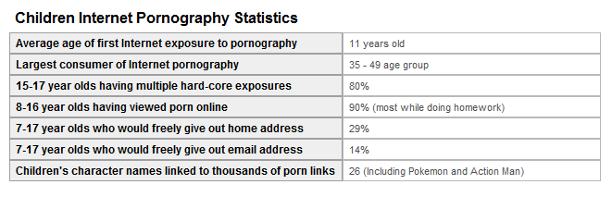
Here’s a Few More “Facts”…

Slide 21
Parental Concern
 | Very concerned | Somewhat concerned | Total citing concerns about negative impact | Not too concerned | Not at all concerned | Total saying they have little/no concern
Your child’s exposure to inappropriate content through the internet or cell phones | 47% | 34% | 81% | 9% | 9% | 19%
How teens in general treat each other online or on their cell phones | 45% | 35% | 80% | 10% | 9% | 19%
Your child’s internet or cell phone use taking time away from face-to-face interactions with friends or family | 31% | 33% | 63% | 20% | 16% | 36%
Notes:
Source: The Pew Research Center's Internet & American Life Teen-Parent survey, April 19-July 14, 2011. N=799 for teens and parents, including oversample of minority families. Interviews were conducted in English and Spanish.

Slide 22
    ThinkUKnow Video “Becky”

Slide 23
Heard this?
A Major Consulting Firm has proposed a new based Life Insurance Assessment test.
Imaginary 40-year-old insurance buyers, "Beth" and "Sarah."
Beth
  commutes some 45 miles to work,
  frequently buys fast food,
  walks for exercise,
  watches a lot of television,
  buys weight-loss equipment
  and has "foreclosure/bankruptcy indicators."
Sarah
  commutes just a mile to work,
  runs, bikes, plays tennis and does aerobics.
  She eats healthy food, watches little TV and travels abroad.
  She is an "urban single" with a premium bank card and "good financial indicators."
Indications:
  Sarah appears to fall into a healthier risk category.
  Beth seems to be a candidate for a group with worse-than-average predicted mortality.
    Long commute.
    Poor financial indicators.
    Purchases tied to obesity indicators.
    Lack of exercise.
    High television consumption indicators.
“Using readily available data”

Slide 24

So what’s your plan to keep safe?

Slide 25
agenda
Introduction
What’s the fuss – why should parents care?
Ok – So how do I deal with it?
  The Basics
  How do I start – what do I protect?
    PC
    IOS/Mobile Phones
    Gaming
Other Resources

Slide 26




























Family Online Safety Assessment
INTERACTIONS
CONTENT
EMAIL
AUDIOVISUAL
CONTENT
IM, TEXTING, SMS
ELECTRONIC
BOOKS
UNKNOWN
PERSONS
DEVICES
UNWANTED
CONTENT
GAMES
ONLINE GAMING
LAW
ENFORCEMENT
LAW
ENFORCEMENT
PHOTOS
MUSIC
CONTACT
MANAGEMENT
TOOLS
CONTENT
FILTERING
TOOLS
SOCIAL NETWORKING
SYSTEM
TOOLS
Time,
Reporting,
etc.
WEBSITES
Inappropriate Content
Privacy & Sharing of Personal Information
Inappropriate Contact
Spam and Phishing
Cyberbullying

Slide 27

So what’s the first step?
Awareness & Communication

Slide 28
Awareness & Communication Tasks
Establish Family Guidelines
  WHAT is acceptable content?
    Media, games, websites, chat/group chat apps, etc.
    General rating levels (G, PG, R)
    Content type: adult, violence, etc.
  WHEN are acceptable times of use?
    Schedule of allowable use
      After school, before bedtime, etc.
      Family time, dinner, etc.
  WHERE can this take place?
    Inside Home (Rooms at home)
    Outside of home (Friend’s house, school, car, restaurants, bus, etc.)
  WHY is this important?
    Help the family to understand why this is important to both you and to them.
    Make it personal.
    What are short and long term consequences of noncompliance?
  WHO owns the devices/content?

Slide 29
Awareness & Communication Tasks
  HOW do I ensure a basic level of safety?
    Minimize mistaken access to inappropriate content
      Use parental controls on phones/devices/tv/etc
      Secure Wifi & DNS Proxy (www.opendns.com)
      Use family settings software (www.microsoft.com/security/family-safety)
      Set SafeSearch settings
      Don’t give everyone Admin rights
      Stick to well known sites/games/brands
    Use strong passwords
    Keep everything up to date (OS, Browsers, AV software etc.)
Establish Acceptable Online Behavior
  Keep private information private.
    What is private is a great conversation with your kids
    Treat online interactions with the same respect you treat physical interactions. (Do you know this person? Are you posting a sign in your front yard? Some things should never be shared - like your password.)
    Video “Broken Promises”

Slide 30
Notes:
Source: The Pew Research Center's Internet & American Life Teen-Parent survey, April 19-July 14, 2011. N=799 for teens and parents, including oversample of minority families. Interviews were conducted in English and Spanish.

Slide 31

Internet Safety - Tips for Kids
Guidance for safer online experiences
  Keep your personal information a secret
  Bullying, offensive language, is not OK—make the consequences clear when they communicate to others
  What you post online to the Internet is public and what you post may be viewed forever
  Remind them that people are not always who they say they are
    Young ones should NEVER meet online friends in person
Address problems immediately!!!!
  Teach kids to trust their instincts
    They need to feel comfortable and be open with parents/trusted adult if something makes them uncomfortable
    Ignore, block, and report unsettling conduct
Phineas:
Ferb:
Enjoy it while it lasts, Candace. Fame is fleeting.
But the Internet is forever.
Article – Nearly 3 years later deleted Facebook photos still online.

Slide 32
Tools to help with Awareness
www.GetGameSmart.com
  Parents Checklist
  The PACT and Pledge
  Setting Device Parental Controls (Links)
http://www.staysafeonline.org/ or http://www.saferinternetday.org
Sign up for the GetGameSmart newsletter or other industry newsletter to stay aware of current trends

Slide 33
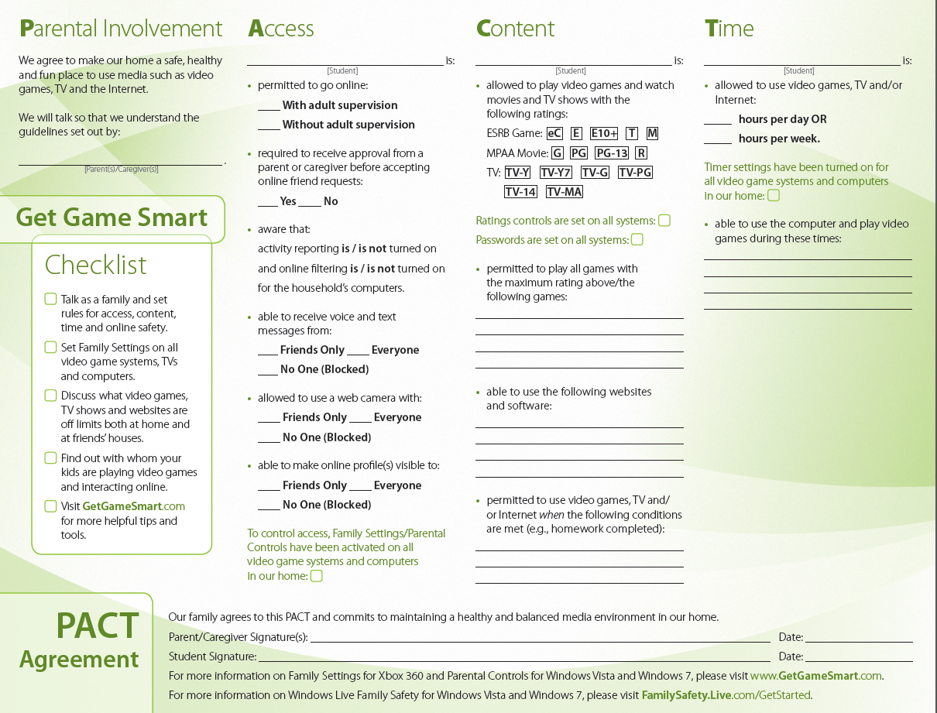

Slide 36
agenda
Introduction
What’s the fuss – why should parents care?
Ok – So how do I deal with it?
  The Basics
  How do I start – what do I protect?
    PC
    IOS/Mobile Phones
    Gaming
Other Resources

Slide 37
NOW for the technology.
INTERACTIONS
CONTENT
EMAIL
AUDIOVISUAL
CONTENT
IM, TEXTING, SMS
ELECTRONIC
BOOKS
UNKNOWN
PERSONS
DEVICES
UNWANTED
CONTENT
GAMES
ONLINE GAMING
LAW
ENFORCEMENT
LAW
ENFORCEMENT
PHOTOS
MUSIC
CONTACT
MANAGEMENT
TOOLS
CONTENT
FILTERING
TOOLS
SOCIAL NETWORKING
SYSTEM
TOOLS
Time,
Reporting,
etc.
WEBSITES
Inappropriate Content
Privacy & Sharing of Personal Information
Inappropriate Contact
Spam and Phishing
Cyberbullying
Notes:
Like in most situations, the technology is an enabler, not a panacea. Don’t plan on technology stopping bad behavior, or changing a person. Technology can only limit innocent access to unwanted content, and arm the parent with reporting of what has happened. I.E. build AWARENESS for the sake of conversation, and through this curb behavior. Generally a teenager who really wants to get access to inappropriate content will find a way. The only way to change this is to change the teens attitude towards that content.

Slide 38
How to start/What should you protect?
Your Home
  Stop the mistakes – eliminate unintended access to “bad” content
    Secure Wifi connection
    DNS Proxy Services to eliminate the unintended access to “bad” content
      HAVE YOU HEARD OF peacefire.org? or dynamic-proxy.com?
    Enable SafeSearch settings in all Search providers (Bing & Google)
Your Devices (Filtering, Parental Controls, Monitoring)
  Ipod/Ipad/Iphone (IOS Parental Controls; IOS Internet)
  Mobile Phones
  PC
  Gaming Systems
    Xbox
    Wii

Slide 39
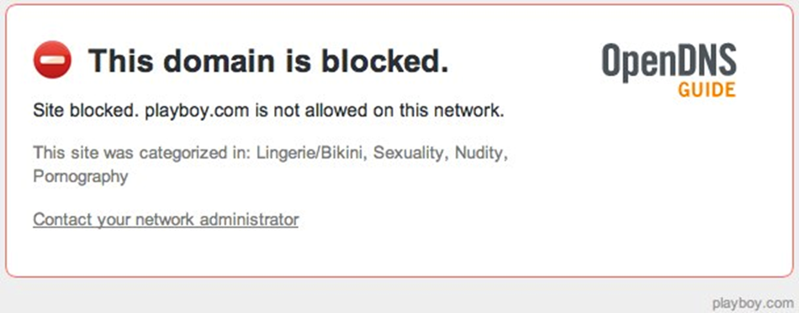
Open DNS (or other DNS Proxy Services)
http://www.opendns.com
back

Slide 40
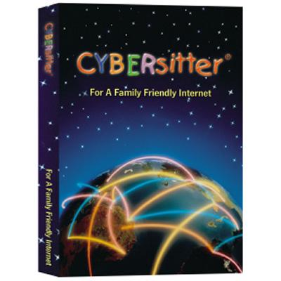


Parental Computer Controls
Schedule Internet access
Block MySpace and other time wasters
Stop inappropriate chat and child predators
Receive email and mobile alerts
Stop illegal file sharing
Monitor where your children are going online
Back

Slide 41
Important PC Steps
Use up to date operating system like Windows 7
Do not allow your children to have admin accounts
Load an Anti-Virus\Malware prevention tool (Microsoft Security Essentials is free!)
Load an updated browser (IE9 is released!)
Set Windows Update to auto install updates
Set up a Windows account for each child
Download Windows Live Essentials 2011 components, including Family Safety, on each compute, then configure Family Safety accounts for each child and associate them with the child’s PC account
Load additional monitoring tools like Spector Pro if needed

Slide 42
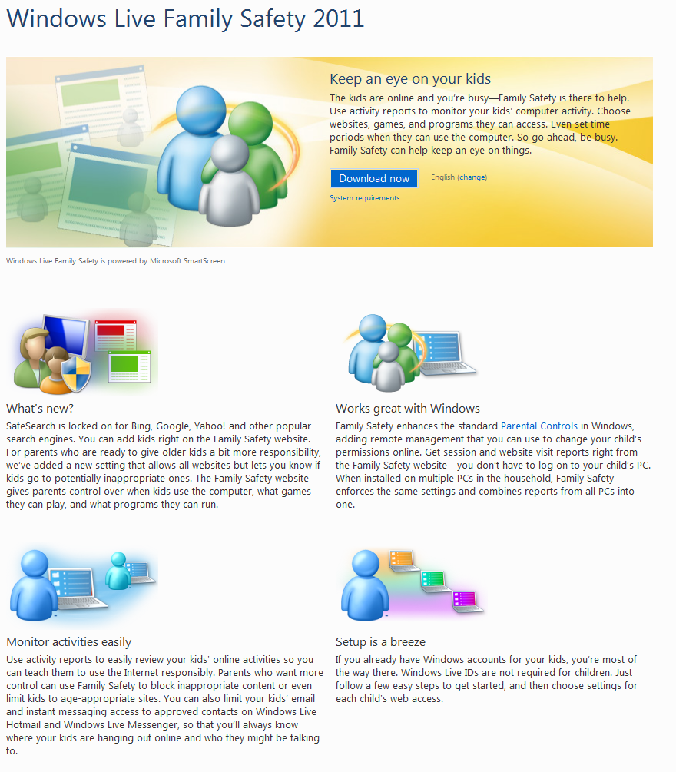
Windows Live Family Safety

Slide 43
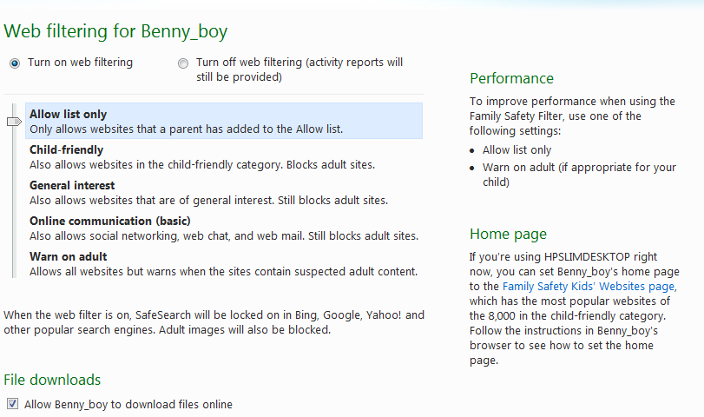
Family Safety and Windows 7 Parental Control Features

Slide 44
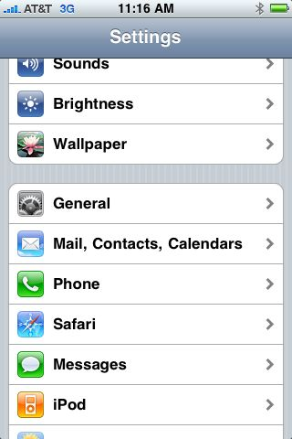
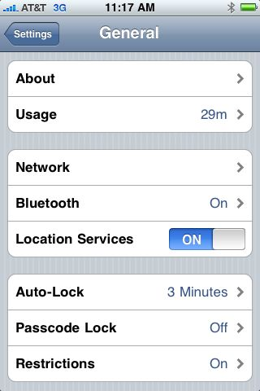
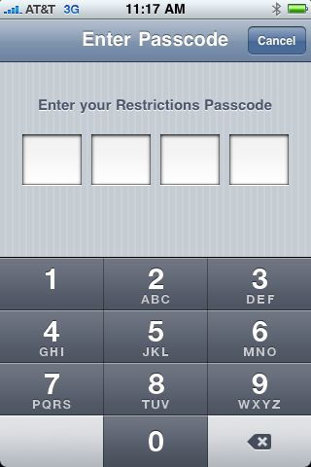
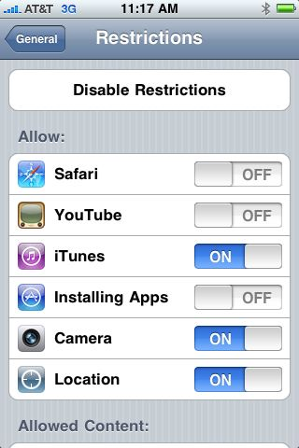
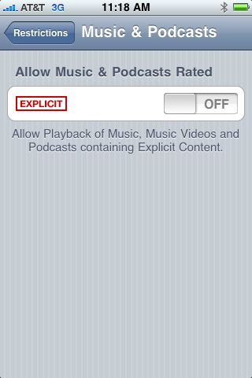
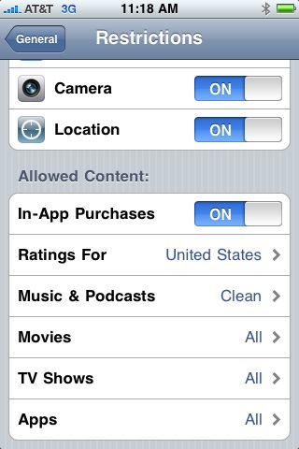
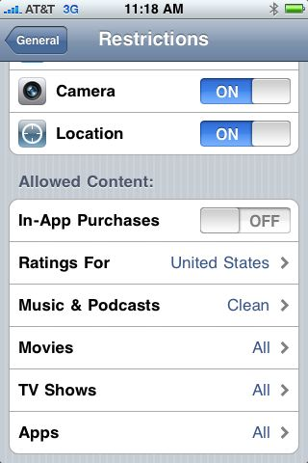
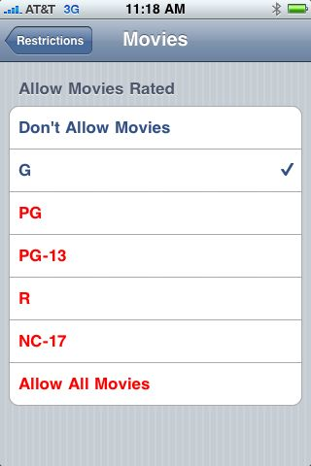
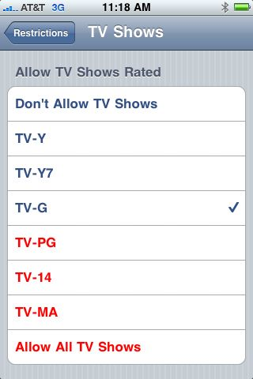
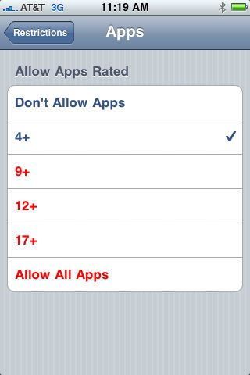
IOS – iPod, iPad, iPhone – Setting Restrictions
Back
Notes:
Discuss DS, Android as well.

Slide 45
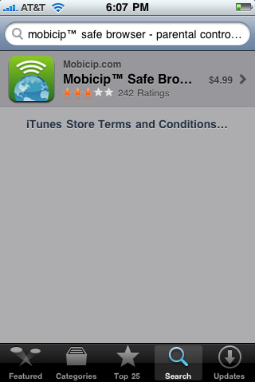
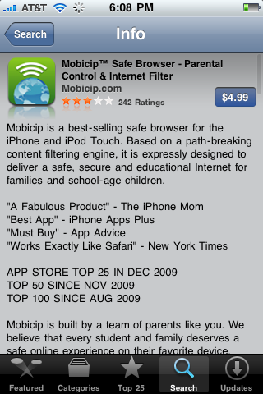
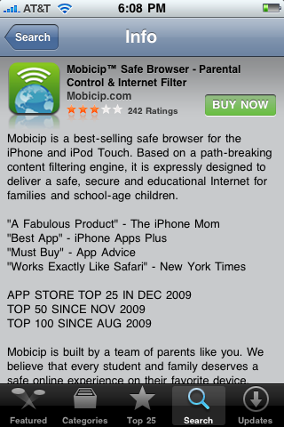
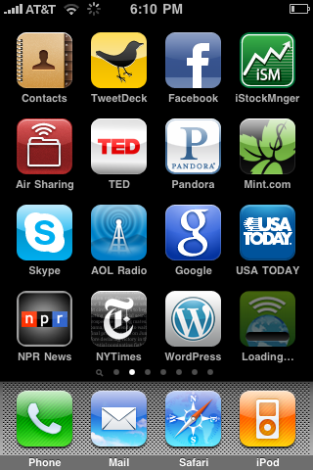

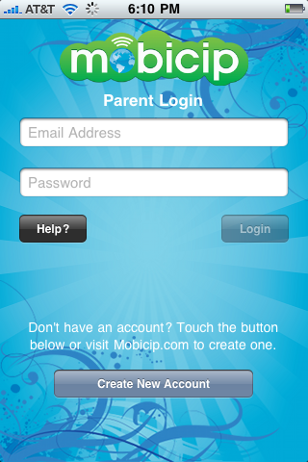
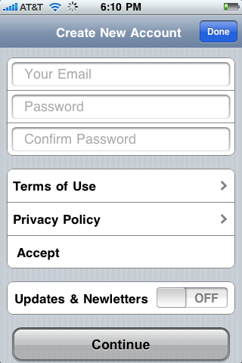
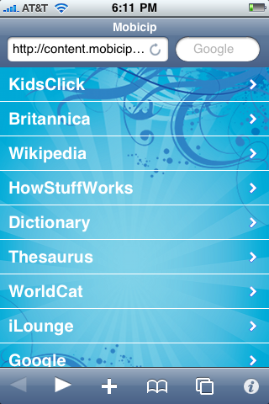
IOS – iPod, iPad, iPhone – Internet
Back

Slide 46
Mobile phones
Http://icanstalku.com/ THIS IS SCARY!!
  Do you know what Geotagging is?
    The storage of location based data, in the form of Latitude and Longitude inside of images is called Geotagging; essentially tagging your photograph with the geographic location
    http://icanstalku.com/how.php
  Does your phone do it and should you turn it off?
    http://icanstalku.com/how.php#disable
    iPhone app - Pixelgarde Photo Privacy Editor (blocks tagging)
  Let’s look at 2 examples.. www.Icanstalku.com and www.windowsphone.com
Back

Slide 47
The last step?
Awareness & Communication

Slide 48
Online Resources
Kinect for Xbox 360
  http://www.xbox.com/en-US/kinect
Microsoft Protect Sites Worldwide
  http://www.microsoft.com/protect/worldwide/default.aspx
Microsoft Safer Internet Day Site
  http://www.microsoft.com/privacy/sid/
GetGameSmart
  www.getgamesmart.com
INSAFE
  www.saferinternet.org
www.netsmartz.org
www.safeteens.com
www.blogsafety.com
www.wiredsafety.org/safety/index.html
www.us-cert.gov/cas/tips/ST06-002.html

Slide 49
Other resources
Be Safe Online (http://www.besafeonline.org/)—This site discusses common problems associated with e-mail, instant messaging, and file sharing.
Be Web Aware (http://www.bewebaware.ca/english/default.aspx)—Safety tips are organized by age group on this site. It also includes a database of kid-friendly web sites.
Get Net Wise (http://www.getnetwise.org/)—A site created and maintained by the Internet Education Foundation, it is a resource for understanding the Internet and how to protect your family from potential Internet-related problems.
i-Safe (http://www.isafe.org/)—A well-organized site that provides information for parents, children, and educators. Many suggestions for filtering and monitoring Internet use can be found at this site.
Wired Safety (http://www.wiredsafety.org/)—This site contains many resources to promote responsible and safe computer use.
See real life stories of some bad things that have happened through personal communication on the Internet at netsmartz.org.
Notes:
Hope this helps
These resources can be found in your packets.

